Slide 1
ERP Implementation for Bridge and Roof

Slide 2
CONTENTS
01
Multiple types of Construction ERP modules
02
ERP Software for Infrastructure and construction industry
03
ERP system implementation phases in Construction Industry
04
Key Components of Construction ERP Software
05
Multiple types of construction ERP value drivers
06
Construction Project Management Flow
07
Comprehensive ERP solutions for construction business
08
ERP Dashboard

Slide 3
Multiple types of Construction ERP modules
Types of Modules
Usability
Inventory
Use wireless management system to track equipment movement
Project Management
use this module to handle sales orders and determining an efficient shipping schedule
Logistics
Project management tools can be used by contractors for Shop floor routing, waste management
Supply Chain Management
Contractor can use this module to track Purchase order, Point of sale transactions
Workforce
Use this module for Time tracking, task management

Slide 4

ERP Software for Infrastructure and construction industry
ERP software will provide many benefits to construction industry such as:
ERP
Workflow
Efficiency Booster
Manage BOM
Different access for different level of users
Project Planning
Project Budgeting
Fully automated software
Purchase & Stores
Accounts

Slide 5

ERP system implementation phases in Construction Industry
System Requirement Study and Gap Analysis
System Implementation
1
5
User Acceptance Test and Data Loading
System Design
2
ERP
6
Development & Configuration
7
System GO-Live
3
4
Staff Training
System Integration Testing
8

Slide 6

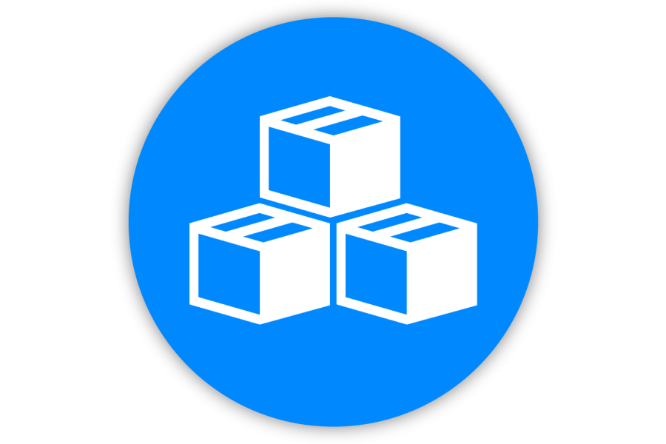





Key Components of Construction ERP Software
Sales
Management
Material
Management
Inventory
Management
Project
Management
Sales management components used to track cost of:
Labor
Material & Equipment
Material Management function feature is used for:
Order Materials
Create Purchase Orders
Inventory management feature is used for:
Stock tracking
Barcode scanning of the products
This feature assist contractor in:
Creating daily field reports
Issues change requests
Payroll
Management
Financial
Management
Service
Management
Track payments to labors and other employees
Analyze the project profitability
Create service contracts, postERP implementation for maintenance

Slide 7


Multiple types of construction ERP value drivers
Project
Financial Control
Change Management
Site Construction Management
Resource Management
Collaboration and Communication

Slide 8
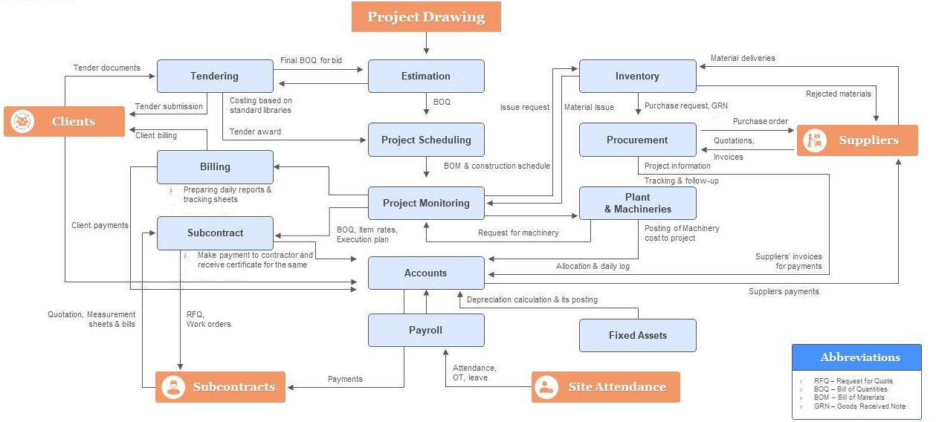
Construction Project Management Flow

Slide 9
Comprehensive ERP solutions for construction business
Alerts & Notifications
Support for Web & mobile view
Automatic email sent to the PM, if any issue is detected in the project
Project
Cost Management
Track construction project progress via any device 24/7
Tender Bid Management
Integration with BIM (Building Information Model)
Project Monitoring and control
Analytics and Dashboard
Use BIM models to detect issues in design during pre-construction phase
Prepare analytical data report of constructing project using dashboard
Subcontractor Management
Plant & Machinery
Seamless Integration
Project
Scheduling
Configurable Workflow
A common platform to share construction project information backed by creative technology
Integrate construction business activities with easily configurable workflows

Slide 10
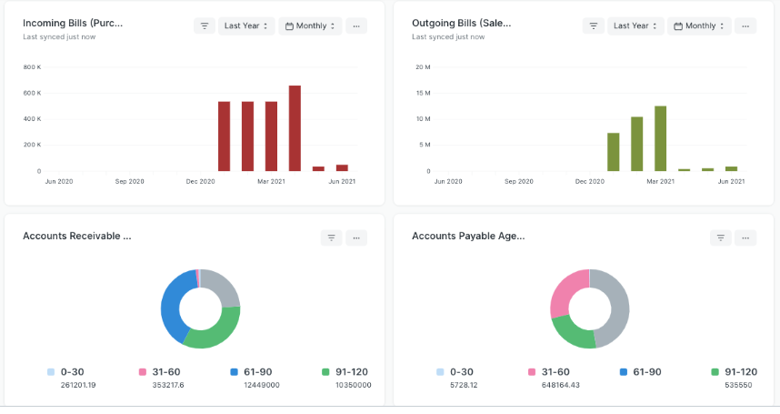
ERP Dashboard
Following is an example of ERP dashboard illustrating the results of different form present in the system.

Slide 11
THANK YOU

